Slide 1
Greedy Algorithm
Course Code: CSC2211
Course Title: Algorithms
Dept. of Computer Science
Faculty of Science and Technology
Lecturer No: | 06 | Week No: | 06 | Semester: | Spring 20-21
Lecturer: | Mushfiqur Rahman; mushfiqur@aiub.edu

Slide 2
Lecture Outline
Optimization Problem
Greedy Algorithm.
Coin Changing Problem.
Fractional knapsack Problem.
Huffman Encoding.
Activity Selection Problem.

Slide 3
Optimization Problems
An optimization problem is one in which you want to find, not just a solution, but the best solution
Example
Graph coloring optimization problem: given an undirected graph, G= (V,E), what is the minimum number of colors required to assign “colors” to each vertex in such a way that no two adjacent vertices have the same color
Path optimization problem: Find the shortest path(s) from u to v in a given graph G.
a
b
Find all the shortest paths from a to d:
a →b →d
a →c →d
d
c

Slide 4
Greedy Algorithm
Solves an optimization problem
For many optimization problems, greedy algorithm can be used. (not always)
Greedy algorithm for optimization problems typically go through a sequence of steps, with a set of choices at each step. Current choice does not depend on evaluating potential future choices or pre-solving repeatedly occurring subproblems (a.k.a., overlapping subproblems). With each step, the original problem is reduced to a smaller problem.
Greedy algorithm always makes the choice that looks best at the moment.
It makes a locally optimal choice in the hope that this choice will lead to a globally optimal solution.

Slide 5
Optimal Solution
What is an Optimal Solution?
Given a problem, more than one solution exist
One of the solution is the best based on some given constraints, that solution is called the optimal solution
What is Global Optimal Solution?
Optimal Solution to the main problem
What is local Optimal Solution?
Optimal Solution to the sub-problems

Slide 6
Example of Greedy Algorithms
Activity Selection Problem
Coin Changing Problem
Job Scheduling Problem
Fractional Knapsack Problem
Dijkstra’s Shortest Path Problem
Minimum Spanning Tree Problem

Slide 7
Greedy algorithms
Coin changing problem
Definition
Given coin denominations in {C }, make change for a given amount
A with the minimum number of coins.
Example:
Coin denominations, C = {25,10,5,1} Amount to change, A = 73
Choose 2 25 coins, so remaining is 73 − 2 ∗25 = 23
Choose 2 10 coins, so remaining is 23 − 2 ∗10 = 3
Choose 0 5 coins, so remaining is 3
Choose 3 1 coins, so remaining is 3 − 1 ∗3 = 0
Solution (and it’s optimal): 2 × 25 + 2 × 10 + 3 × 1 = 7 coins
Key Question
Does a greedy approach always produce the optimal solution?
34 / 38

Slide 8
Coin changing problem (continued)
Coin denominations, C = {12, 5, 1} Amount to change, A = 15
Example (using greedy strategy)
Choose 1 12 coins, so remaining is 15 − 1 ∗12 = 3
Choose 3 1 coins, so remaining is 3 − 1 ∗ 3 = 0
Solution: 4 coins.
Example (using optimal strategy)
Choose 0 12 coins, so remaining is 15
Choose 3 5 coins, so remaining is 15 − 3 ∗ 5 = 0
Solution: 3 coins.
Correctness depends on the choice of coins,
so greedy strategy does not provide a general solution to this problem!
35 / 38

Slide 9
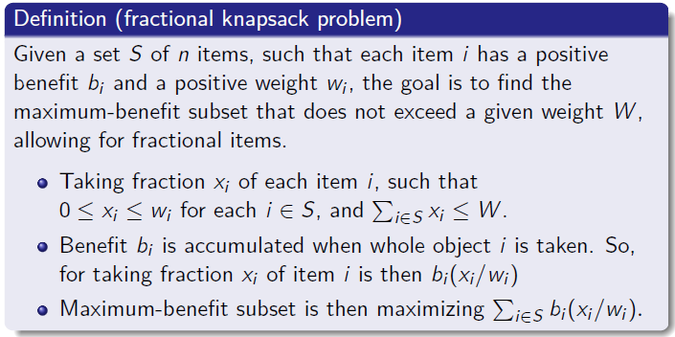
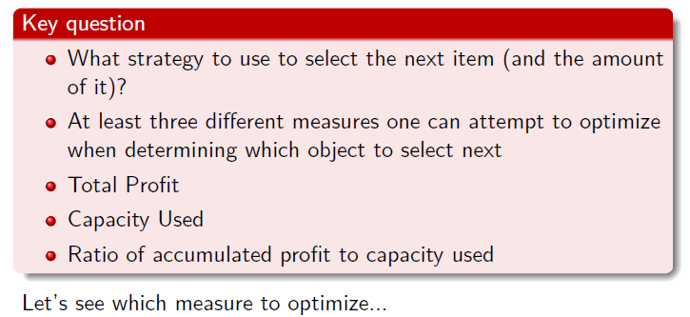
Fractional knapsack problem
24 / 38

Slide 10
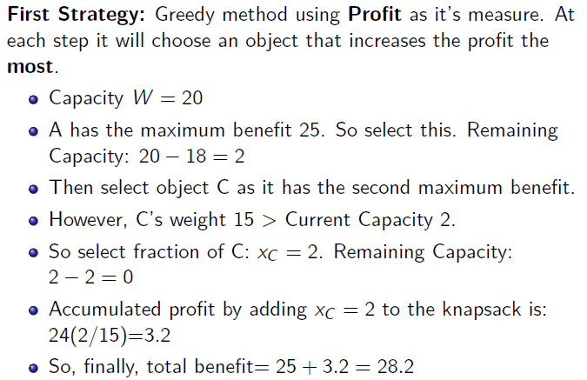
Fractional knapsack problem
Capacity W=20
Item | Benefit | Weight
A | 25 | 18 kg
B | 15 | 10 kg
C | 24 | 15 kg

Slide 11
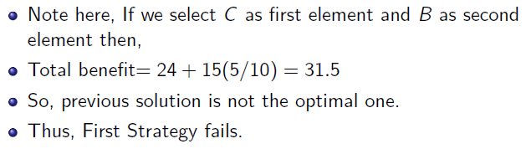
Fractional knapsack problem
Item | Benefit | Weight
A | 25 | 18 kg
B | 15 | 10 kg
C | 24 | 15 kg
27 / 38

Slide 12
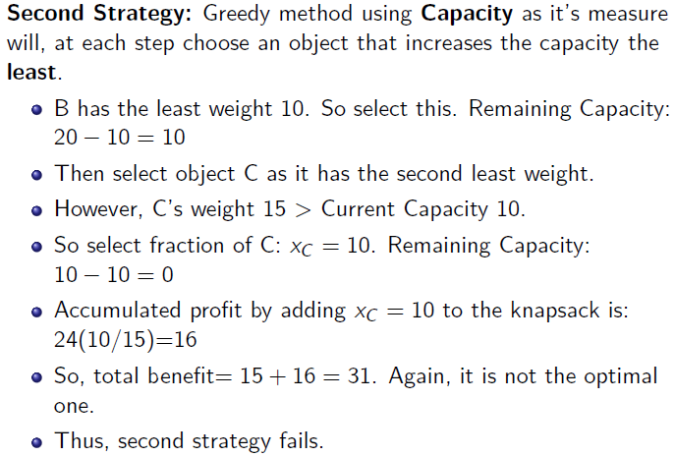
Fractional knapsack problem
28 / 38

Slide 13
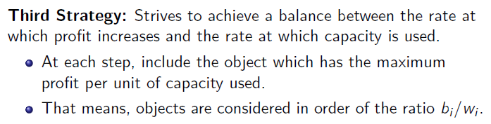
Fractional knapsack problem

Slide 14
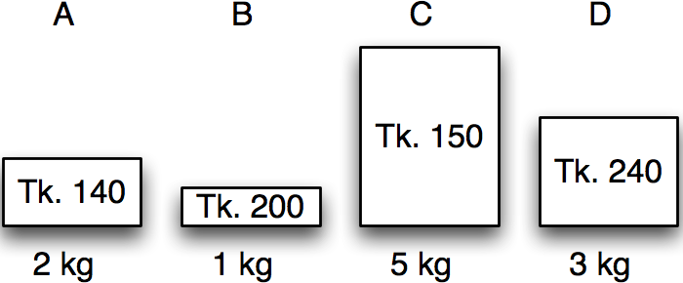
Greedy algorithms
Fractional knapsack in action
Item | Benefit | Weight
A | 140 | 2 kg
B | 200 | 1 kg
C | 150 | 5 kg
D | 240 | 3 kg
Calculate benefit/kg – the value index.

Slide 15
Greedy algorithms
Fractional knapsack in action
Item | Benefit | Weight | Value index
A | 140 | 2 kg | 70
B | 200 | 1 kg | 200
C | 150 | 5 kg | 30
D | 240 | 3 kg | 80
Sort by non-increasing value index.
Licensed under
30 / 38

Slide 16
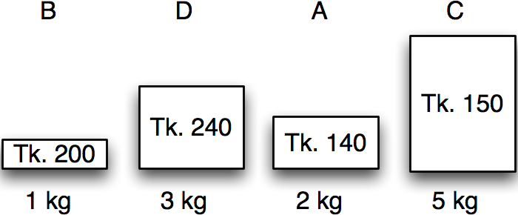
Greedy algorithms
Fractional knapsack in action
Item | Benefit | Weight | Value index
B | 200 | 1 kg | 200
D | 240 | 3 kg | 80
A | 140 | 2 kg | 70
C | 150 | 5 kg | 30
Maximum weight:
5 kg
30 / 38

Slide 17
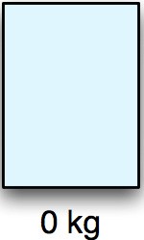
Greedy algorithms
Fractional knapsack in action
Item | Benefit | Weight | Value index | Chosen
B | 200 | 1 kg | 200 | 0 kg
D | 240 | 3 kg | 80 | 0 kg
A | 140 | 2 kg | 70 | 0 kg
C | 150 | 5 kg | 30 | 0 kg
Maximum weight:
5 kg
Remaining:
5 kg
Benefit:
0
30 / 38

Slide 18
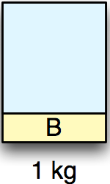
Greedy algorithms
Fractional knapsack in action
Item | Benefit | Weight | Value index | Chosen
B | 200 | 0 kg | 200 | 1 kg
D | 240 | 3 kg | 80 | 0 kg
A | 140 | 2 kg | 70 | 0 kg
C | 150 | 5 kg | 30 | 0 kg
Maximum weight:
5 kg
Remaining:
4 kg
Benefit:
200
30 / 38

Slide 19
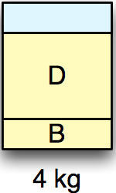
Greedy algorithms
Fractional knapsack in action
Item | Benefit | Weight | Value index | Chosen
B | 200 | 0 kg | 200 | 1 kg
D | 240 | 0 kg | 80 | 3 kg
A | 140 | 2 kg | 70 | 0 kg
C | 150 | 5 kg | 30 | 0 kg
Maximum weight:
5 kg
Remaining:
1 kg
Benefit:
440
30 / 38

Slide 20
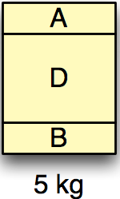
Greedy algorithms
Fractional knapsack in action
Item | Benefit | Weight | Value index | Chosen
B | 200 | 0 kg | 200 | 1 kg
D | 240 | 0 kg | 80 | 3 kg
A | 140 | 1 kg | 70 | 1 kg
C | 150 | 5 kg | 30 | 0 kg
Maximum weight:
5 kg
Remaining:
0 kg
Benefit:
510
30 / 38

Slide 21
Greedy algorithms
Fractional knapsack in action
Item | Benefit | Weight | Value index | Chosen
B | 200 | 0 kg | 200 | 1 kg
D | 240 | 0 kg | 80 | 3 kg
A | 140 | 1 kg | 70 | 1 kg
C | 150 | 5 kg | 30 | 0 kg
Maximum weight:
5 kg
Remaining:
0 kg
Benefit:
510
30 / 38

Slide 22
Exercise-1
Assume that we have a knapsack with max weight capacity, W = 16. our objective is to fill the knapsack with items such that the benefit (value or profit) is maximum. Consider the following items and their associated weight and value
ITEM | WEIGHT | VALUE
i1 | 6 | 6
i2 | 10 | 2
i3 | 3 | 1
i4 | 5 | 8
i5 | 1 | 3
i6 | 3 | 5

Slide 23
Exercise-2
Tony needs to buy 21 liters of orange juice for his upcoming birthday party. He asked a few juice vendors and collected the information about their stock of orange juice and their price.
He has some other important jobs to do and hired you to find out how he should buy 21 liters of orange juice from different vendors by spending as little as possible.
The quantity and price of orange juice from each vendor is given in the following table, you need to tell Tony how much money he has to spend and from which vendor how much orange juice to be bought. Specify the steps of your solution in short with simulation.
ITEM | Amount (L) | Price ($)
i1 | 16 | 10
i2 | 16 | 8
i3 | 10 | 6
i4 | 7 | 3
i5 | 1 | 1

Slide 24
Huffman encoding
The Huffman encoding algorithm is a greedy algorithm
You always pick the two smallest numbers to combine
100
Average bits/char: 0.22*2 + 0.12*3 + 0.24*2 + 0.06*4 + 0.27*2 + 0.09*4 = 2.42
The Huffman algorithm finds an optimal solution
54
27
A=00 B=100 C=01 D=1010 E=11 F=1011
46
15
22 12 24 6 27 9 A B C D E F
Notes:
8

Slide 25
Books
Introduction to Algorithms, Thomas H. Cormen, Charle E. Leiserson,
Ronald L. Rivest, Clifford Stein (CLRS).
Fundamental of Computer Algorithms, Ellis Horowitz, Sartaj Sahni, Sanguthevar Rajasekaran (HSR)

Slide 26
References
https://www.tutorialspoint.com/data_structures_algorithms/greedy_algorithms.htm
https://www.geeksforgeeks.org/fractional-knapsack-problem/
https://www.geeksforgeeks.org/activity-selection-problem-greedy-algo-1/
https://www.tutorialspoint.com/Huffman-Coding-Algorithm
https://www.geeksforgeeks.org/huffman-coding-greedy-algo-3/

